Slide 1

Music Store Data Analysis

Slide 2
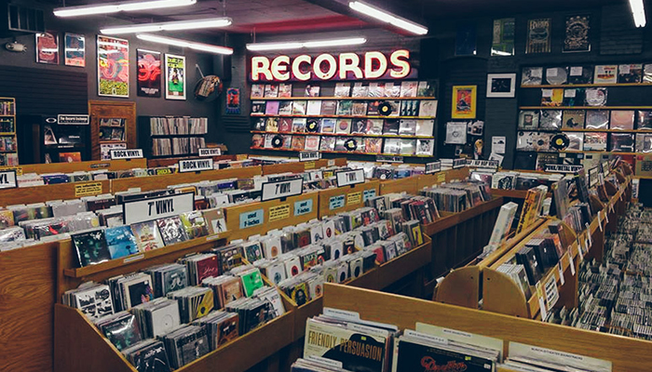

MUSIC
STORE
DATA ANALYSIS
This Photo by Unknown Author is licensed under CC BY-NC-ND

Slide 3


About me
I have recently completed my B.Tech Data Science from G.H Raisoni College Of Engineering, Jalgaon.
I have prior experience in Python and data manipulation, SQL, so I developed a strong interest in the field of Data Science.
Motivated by this passion, I have decided to pursue Data Science as my career path.
Here are links to my GitHub and LinkedIn profiles.
https://github.com/Kartik0224
https://www.linkedin.com/in/kartik-patil-ba4960240/

Slide 4
Agenda (This should be the PPT flow)
Objective of the Project
ER Diagram and schema explanation
Key analysis questions (use cases)
SQL query results with screenshots or summaries
Final business insights and recommendations
Conclusion (Key finding overall)
Q&A Slide
Your Experience/Challenges working on SQL – Data Analysis Project.

Slide 5
Objective of the Project
The main objective of this SQL-based Data Analysis project was to explore and analyze the music store database to extract meaningful insights. The goals included:
Understanding customer behavior and purchase trends.
Analyzing sales performance across genres, artists, and countries.
Identifying top-selling tracks, albums, and customers.
Helping the business make data-driven decisions regarding marketing, inventory, and expansion.
This involved querying various tables using SQL (e.g., Customers, Invoices, Tracks, Albums, Artists, Genres) and combining them using joins, filters, groupings, and aggregations to derive insights from raw data.

Slide 6
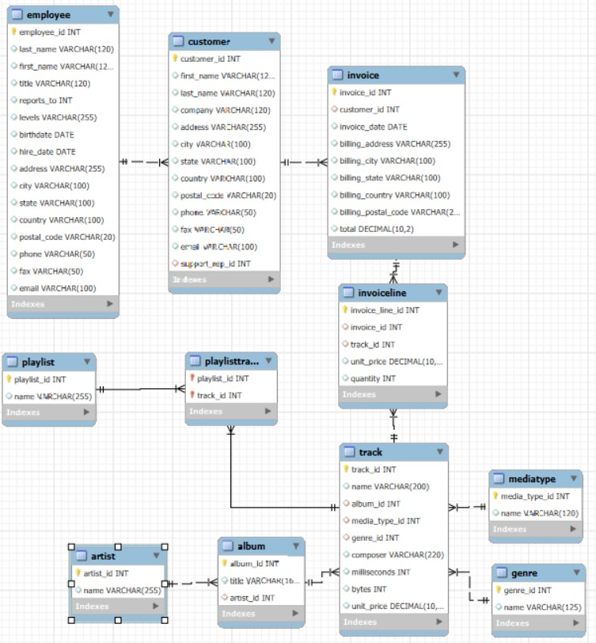
ER Diagram and schema explanation

Slide 7


1. Who is the senior most employee based on job title?

Slide 8

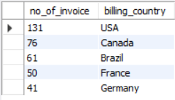
2. Which countries have the most Invoices?

Slide 9


3. What are the top 3 values of total invoice?

Slide 10
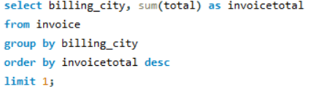

4. Which city has the best customers? - We would like to throw a promotional Music Festival in the city we made the most money. Write a query that returns one city that has the highest sum of invoice totals. Return both the city name & sum of all invoice totals

Slide 11
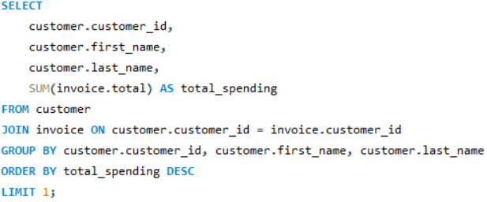

5. Who is the best customer? - The customer who has spent the most money will be declared the best customer. Write a query that returns the person who has spent the most money

Slide 12
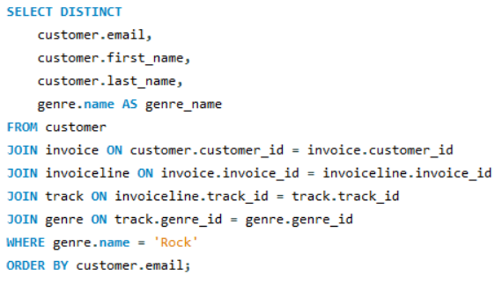
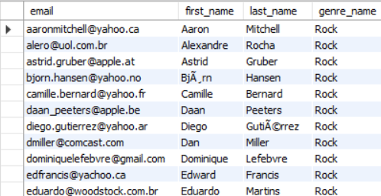
6. Write a query to return the email, first name, last name, & Genre of all Rock Music listeners. Return your list ordered alphabetically by email starting with A

Slide 13
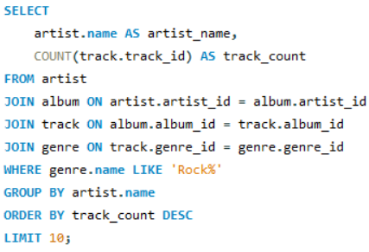
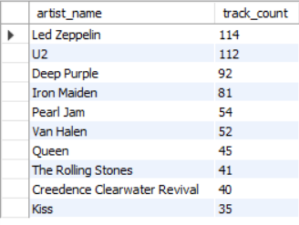
7. Let's invite the artists who have written the most rock music in our dataset. Write a query that returns the Artist name and total track count of the top 10 rock bands

Slide 14

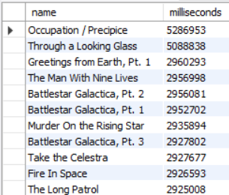
8. Return all the track names that have a song length longer than the average song length.- Return the Name and Milliseconds for each track. Order by the song length, with the longest songs listed first

Slide 15
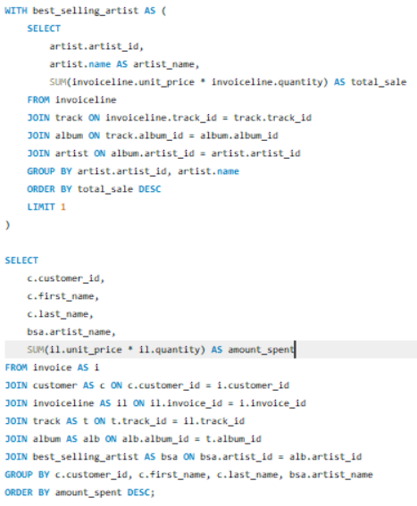
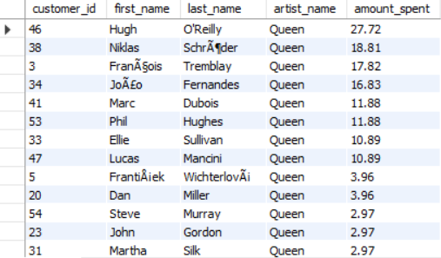
9. Find how much amount is spent by each customer on artists? Write a query to return customer name, artist name and total spent

Slide 16
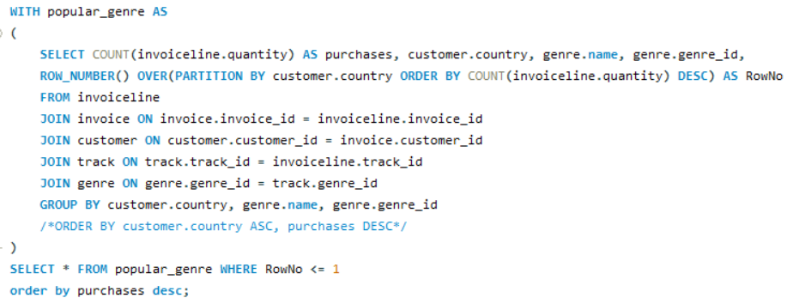
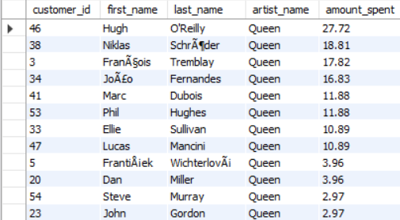
10. We want to find out the most popular music Genre for each country. We determine the most popular genre as the genre with the highest amount of purchases. Write a query that returns each country along with the top Genre. For countries where the maximum number of purchases is shared, return all Genres

Slide 17
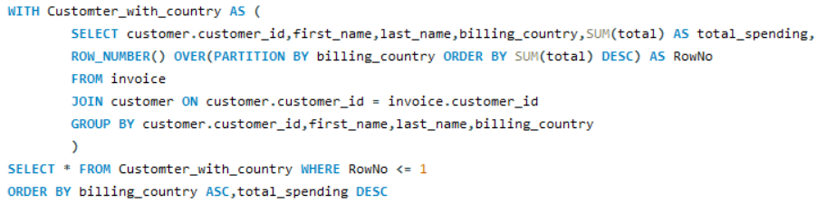
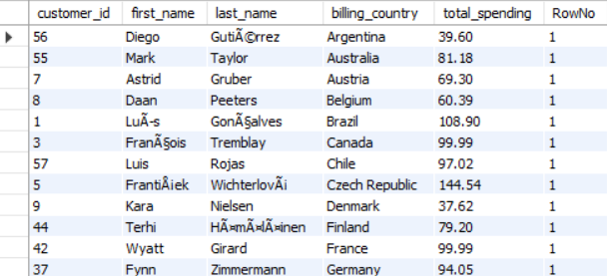
11. Write a query that determines the customer that has spent the most on music for each country. Write a query that returns the country along with the top customer and how much they spent. For countries where the top amount spent is shared, provide all customers who spent this amount

Slide 18
Conclusion
The SQL analysis of the Music Store dataset uncovered key insights such as top customers, most popular genres, and high-performing regions. These findings support better business strategies and data-driven decision-making for growth. It enhanced understanding of customer preferences and purchasing patterns. Identifying top artists and tracks helped in recognizing revenue-driving content. City-wise and country-wise trends can guide targeted promotions. Overall, the project demonstrated the power of SQL in real-world data analysis.

Slide 19

THANK YOU

